Slide 1
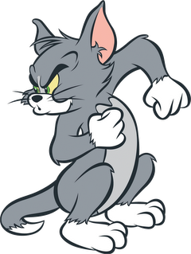
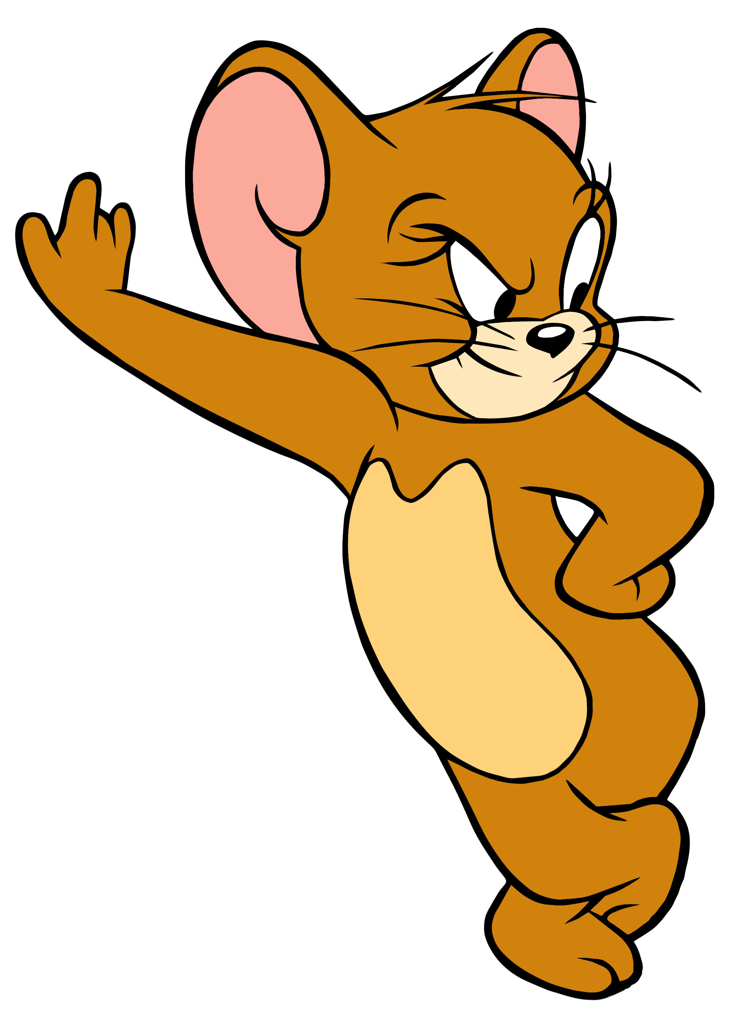
Tom&Jerry Jigsaw Puzzle

Slide 2
Tom&Jerry Jigsaw Puzzle
A jigsaw puzzle is a tiling puzzle that requires the assembly of often oddly shaped interlocking and tessellating pieces.
Each piece usually has a small part of a picture on it; when complete, a jigsaw puzzle produces a complete picture.

Slide 3

Purpose of Our Game
Our game is basically for the enjoyment and mind training of children.
We’ve choose the famous cartoon characters Tom & Jerry for the puzzle picture of our game to gain attention and to make our game interesting.

Slide 4




Developing Platform
You can create any 2D or 3D game with Unity.
You can make it with ease, you can make it highly-optimized and beautiful, and you can deploy it with a click to more platforms than you have fingers and toes.
That’s why we use unity for developing of our game.

Slide 5
C#

Slide 6
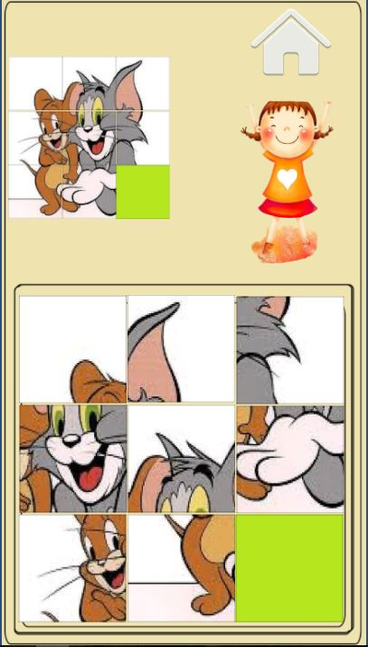
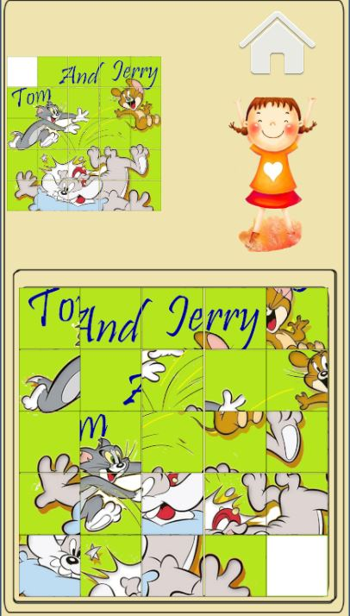
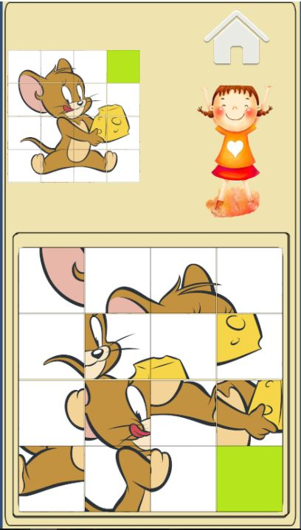
3 levels in Game
Easy
Medium
Hard
Notes:
Face rectangle (left, top, width and height) indicating the face location in the image is returned along with each detected face. Optionally, face detection extracts a series of face related attributes such as pose, gender, age, head pose, facial hair and glasses.

Slide 7
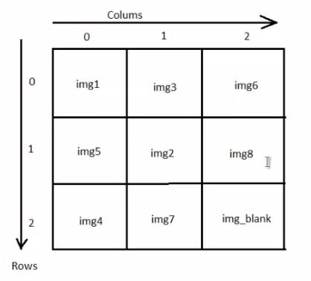
Logics in Game
For Easy Level we have 9 images. We arranged the 9 parts as shown in figure. Blank image is at [2][2]. It plays an important role in movement of blocks. We’ll discuss the logic behind movement of blocks later.

Slide 8
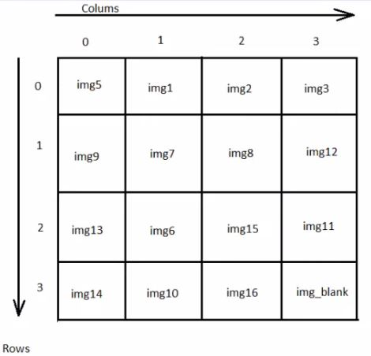
Logics in Game
For Medium Level we have 16 images. We arranged the 9 parts as shown in figure. Blank image is at [3][3].

Slide 9
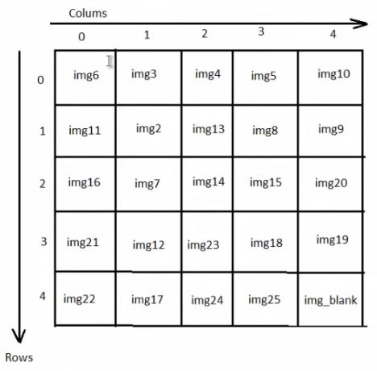
Logics in Game
For Hard Level we have 25 images. We arranged the 9 parts as shown in figure. Blank image is at [4][4].

Slide 10
Image Keys
For every level there is image key on the top of display. This image key is for hint to player and also for coding the completion of game.

Slide 11
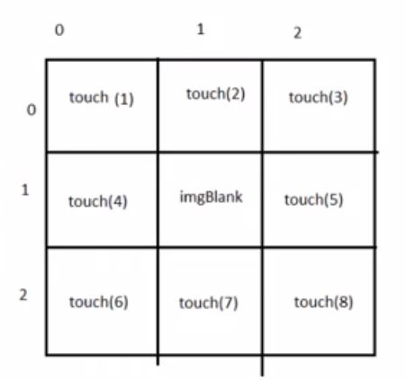
How to know position to move
1- rowOfBlank!=rowOfTouch and columnOfBlank==columnOfTouch
2- columnOfBlank!=columnOfTouch and
ColumnOfBlank==columnOfTouch
Same Conditions apply to above levels.

Slide 12
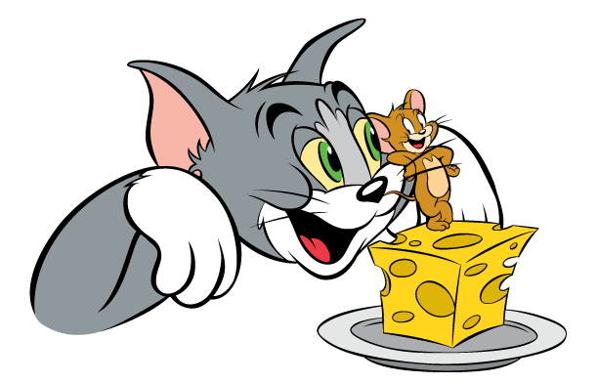
THANKS!
Any questions?

